Slide 1
Report : Lidar Assisted Controller
Date: 21/10/25
Supervisor: prof. David Schlipf
Group members: Midhun Kanichattu Venu,Hesham Mahmoud

Slide 2
Overview
This project presents the implementation of a Lidar-Assisted Control (LAC) strategy for wind turbine optimization. The controller integrates feedforward (FFP), lidar-based (LDP), and feedback (ROSCO) modules through a Wrapper interface in OpenFAST. The objective is to reduce cost and improve stability by tuning the buffer time (T_buffer) parameter.
Hesham Mahmoud 770604

Slide 3
Signal Flow between Simulation Modules (swayArray)
Lidar Simulator → LDP.DLL
Signals provided by Lidar Simulator to LDP.DLL in swayArray
The Lidar Simulator sends measurement data for wind field and turbine response prediction.
These signals include:
Wind speed and direction at various points across rotor plane.
Time-stamped turbulence information.
Scan pattern and range data.
OpenFAST Lidar Simulation
LDP
FFP
ROSCO

Slide 4
Table (Record & Description):
Lidar Simulator → LDP.DLL
Record | Description
vLidarX, vLidarY, vLidarZ | 3D wind velocity components from lidar scan
tScan | Time stamp of measurement
BeamRange | Distance of measurement point from nacelle
SignalQuality | Strength/accuracy of lidar return

Slide 5
LDP.DLL → FFP.DLL
Signals provided by LDP.DLL to FFP.DLL in swayArray
LDP.DLL processes lidar data and converts it into preview wind signals.
These signals are passed to FFP.DLL for control and feed-forward logic.
Table (Record & Description):
Record | Description
vPreview | Predicted wind speed ahead of rotor
YawErr | Estimated yaw misalignment
PitchRef | Feed-forward blade pitch command
FF_Enable | Boolean flag to activate preview control

Slide 6
FFP.DLL → Rosco.DLL
Signals provided by FFP.DLL to Rosco.DLL in swayArray
FFP.DLL generates feed-forward control inputs for the main turbine controller (ROSCO).
These inputs are used to adjust torque and pitch commands dynamically.
Table (Record & Description):
Record | Description
FF_Torque | Feed-forward torque reference
FF_Pitch | Feed-forward pitch adjustment
FF_Status | Control mode or activation signal
vRotor | Effective rotor wind speed estimate

Slide 7
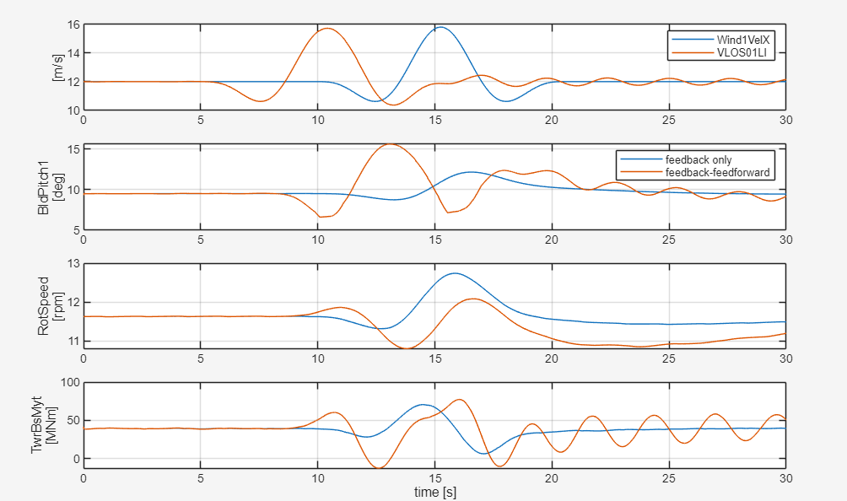
RESULT

Slide 8
Conclusions
The Wrapper successfully integrates FFP, LDP, and ROSCO_FBFF with LAC enabled.
The optimized T_buffer = 3 s reduced total cost and improved system stability.
The control approach is validated for future steady-state and Lidar field implementation.
Hesham Mahmoud 770604

Slide 9
Bibliography – Lidar Assisted controller
Hansen, M. Aerodynamics of Wind Turbines, 3rd Ed., Routledge, 2015.
Ingram, G. Wind Turbine Blade Element Momentum Theory, 2011.
Bossanyi, E. Controller Design for Variable-Speed Wind Turbines, Wind Engineering, 2000
Hesham Mahmoud 770604

